Slide 1

Machine Learning with Scikit-Learn and TensorFlow (자원탐사 융합해석을 위한 파이썬 라이브러리를 활용한 머신러닝)
KIGAM, Mar 19-23, 2018
Day 4
Daeung Yoon (윤대웅)
Hanyang University

Slide 2
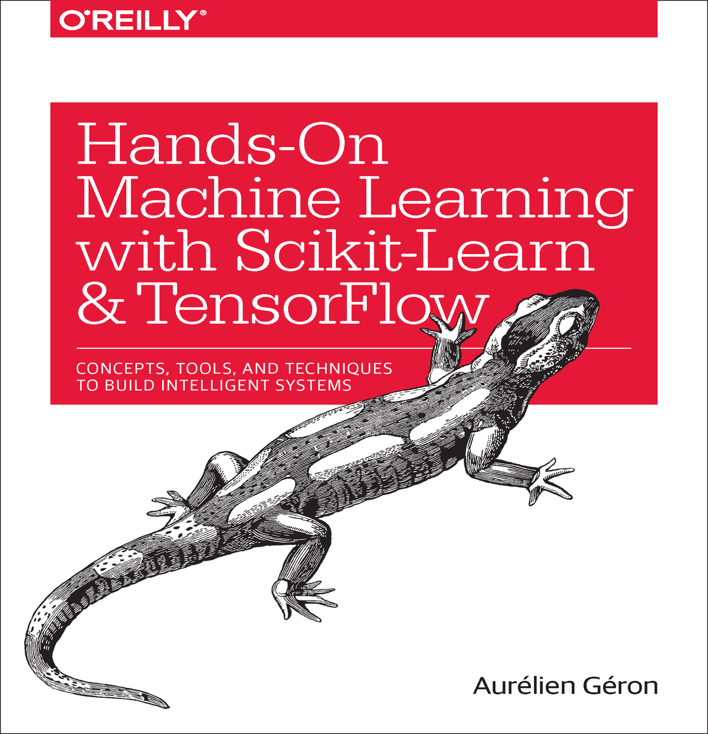
참고 자료
Hands-On Machine Learning with Scikit-Learn and TensorFlow by Aurelien Geron
cs231n (Convolutional Neural Networks for Visual Recognition)
cs224n (Natural Language Processing with Deep Learning)
강의 자료 및 예제코드 다운로드 주소
https://github.com/duyoon/kigam_ml_seminar_2018

Slide 3
교육 시간표
 | 2.19 (월) | 2.20 (화) | 2.21 (수) | 2.22 (목) | 2.23 (금)
오전 | Python for machine learning | Linear/Logistic Regression | Decision Trees | TensorFlow Basics | Convolutional Neural Networks
오후 | Intro to machine learning | Support Vector Machines | Random Forests | Artificial Neural Networks | Convolutional Neural Networks
 | Data Preprocessing | Model Evaluation | Gradient Boosting | Deep Neural Networks | Recurrent Neural Networks

Slide 4
8. Up and Running with TensorFlow

Slide 5
Open source Deep Learning libraries
Library | API | Platforms | Started by | Year
Caffe | Python, C++, Matlab | Linux, macOS, Windows | UC Berkely | 2013
Deeplearning4j | Java, Scala, Clojure | Linux, macOS, Windows, Android | A. Gibson, J.Patterson | 2014
H2O | Python, R | Linux, macOS, Windows | H2O.ai | 2014
MXNet | Python, C++, others | Linux, macOS, Windows, Android, iOS | DMLC | 2015
TensorFlow | Python, C++ | Linux, macOS, Windows, Android, iOS | Google | 2015
Theano | Python | Linux, macOS, iOS | University of Montreal | 2010
Torch | C++, Lua | Linux, macOS, Android, iOS | R. Collobert, K. Kavukcuoglu, C. Farabet | 2002

Slide 6
Highlights of TensorFlow
Runs not only on Windows, Linux, and macOS, but also on iOS and Android
Provides very simple APIs called TF.Learn and TF-slim
Other high-level APIs have been built on top of TensorFlow, such as Keras or Pretty Tensor
Easy computation of the gradients of the functions called automatic differentiating (or autodiff)
Comes with a great visualization tool called TensorBoard
Google also launched a cloud service to run TensorFlow graphs

Slide 7
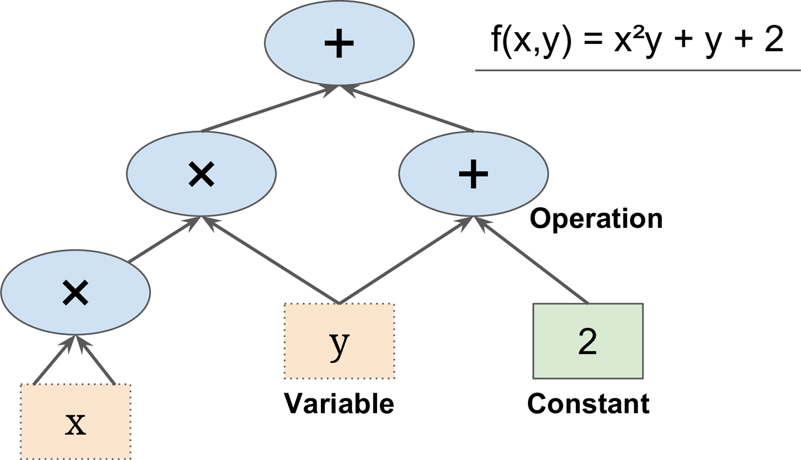
Basic Principle of TensorFlow
Define in Python a graph of computations to perform
TensorFlow takes that graph and runs it efficiently using optimized C++ code.

Slide 8
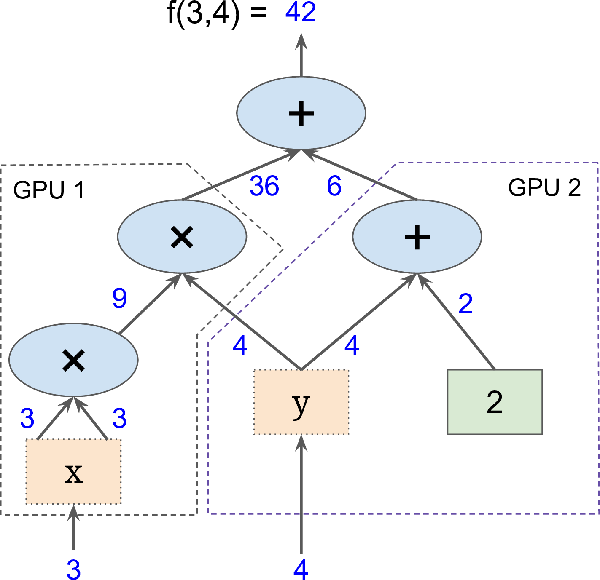
Basic Principle of TensorFlow
Parallel computation on multiple CPUs/GPUs/servers

Slide 9
Tensor types in TensorFlow
tf.constant()
tensor with constant and immutable values
Not require initialization
tf.Variable()
Tensor with variable (and trainable) values
Requires initialization
tf.placeholders()
Dummy tensor node to be fed in the Session.
Not require initialization
tf.Variable()
y = WX + b + 0.1
tf.placeholders()
tf.constant()

Slide 10
Creating a Graph and Running it
1. Create a graph
import tensorflow as tf
x = tf.Variable(3, name=“x”)
y = tf.Variable(4, name=“y”)
f = x*x*y + y + 2
sess = tf.Session()
sess.run(x.initializer)
sess.run(y.initializer)
result = sess.run(f)
print(result)
sess.close
2. Run the graph in a Session

Slide 11
Creating a Graph and Running it
1. Create a graph
import tensorflow as tf
x = tf.Variable(3, name=“x”)
y = tf.Variable(4, name=“y”)
f = x*x*y + y + 2
sess = tf.Session()
sess.run(x.initializer)
sess.run(y.initializer)
result = sess.run(f)
print(result)
sess.close
Construction phase
Execution phase
2. Run the graph in a Session

Slide 12
Creating a Graph and Running it
1. Create a graph
import tensorflow as tf
x = tf.Variable(3, name=“x”)
y = tf.Variable(4, name=“y”)
f = x*x*y + y + 2
with tf.Session() as sess:
x.initializer.run()
y.initializer.run()
result = f.eval()
print(result)
Construction phase
Execution phase
2. Run the graph in a Session
f.eval() is just syntactic sugar for sess.run(f) in the currently active session!

Slide 13
Creating a Graph and Running it
1. Create a graph
import tensorflow as tf
x = tf.Variable(3, name=“x”)
y = tf.Variable(4, name=“y”)
f = x*x*y + y + 2
init = tf.global_variables_initializer()
with tf.Session() as sess:
init.run()
result = f.eval()
print(result)
Construction phase
Execution phase
2. Run the graph in a Session

Slide 14
Example
1. Create a graph
import tensorflow as tf
w = tf.constant(3)
z
y
Construction phase
x
+
3
x
5
Execution phase
+
Use eval() to run the graph
w = 3
2
2. Run the graph in a Session

Slide 15
Example
1. Create a graph
import tensorflow as tf
w = tf.constant(3)
x = w + 2
y = x + 5
z = x * 3
with tf.Session() as sess:
print(y.eval())
print(z.eval())
z
y
Construction phase
x
+
3
x
5
Execution phase
+
w = 3
2
2. Run the graph in a Session

Slide 16
Example
1. Create a graph
import tensorflow as tf
w = tf.constant(3)
x = w + 2
y = x + 5
z = x * 3
with tf.Session() as sess:
print(y.eval())
print(z.eval())
z
y
Construction phase
x
+
3
x
5
Execution phase
+
w = 3
2
2. Run the graph in a Session

Slide 17
Example
1. Create a graph
import tensorflow as tf
w = tf.constant(3)
x = w + 2
y = x + 5
z = x * 3
with tf.Session() as sess:
print(y.eval())
print(z.eval())
z
y
Construction phase
x
+
3
x
5
Execution phase
+
w = 3
2
2. Run the graph in a Session

Slide 18
Example
1. Create a graph
import tensorflow as tf
w = tf.constant(3)
x = w + 2
y = x + 5
z = x * 3
with tf.Session() as sess:
y_val, z_val = sess.run([y, z])
print(y_val)
print(z_val)
z
y
Construction phase
x
+
3
x
5
Execution phase
+
w = 3
2
2. Run the graph in a Session

Slide 19
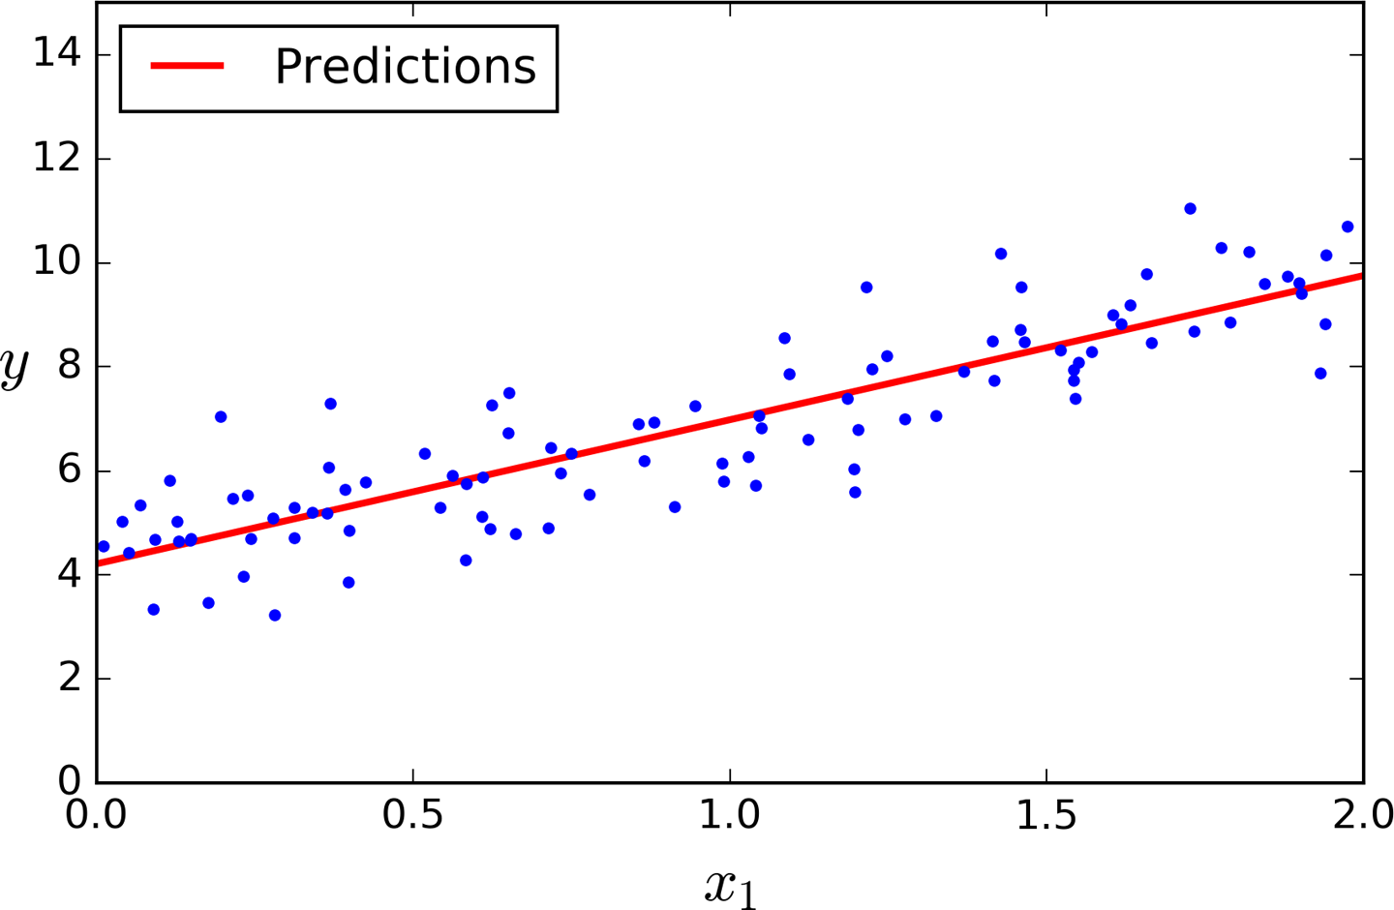
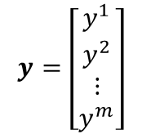
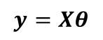
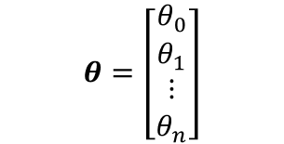

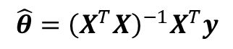
Linear Regression using the Normal Equation with numpy, scikit-learn and TensorFlow
For n dimensions with 1 instance:
$y=θ_{0}+θ_{1}x_{1}+θ_{2}x_{2}$+…+$θ_{n}x_{n}$
For n dimensions with m instances:
$$y=Xθ$$
$$X=\left[\begin{matrix}\begin{matrix}1 & x_{1}^{1} \\ 1 & x_{1}^{2}\end{matrix} & ⋯ & \begin{matrix}x_{n}^{1} \\ x_{n}^{2}\end{matrix} \\ ⋮ & ⋯ & ⋮ \\ \begin{matrix}1 & x_{1}^{m}\end{matrix} & ⋯ & x_{n}^{m}\end{matrix}\right]$$
$$y=\left[\begin{matrix}\begin{matrix}y^{1} \\ y^{2}\end{matrix} \\ \begin{matrix}⋮ \\ y^{m}\end{matrix}\end{matrix}\right]$$
$$θ=\left[\begin{matrix}\begin{matrix}θ_{0} \\ θ_{1}\end{matrix} \\ \begin{matrix}⋮ \\ θ_{n}\end{matrix}\end{matrix}\right]$$
The Normal Equation – a closed-form solution
$$\hat{θ}={\left(X^{T}X\right)}^{−1}X^{T}y$$

Slide 20
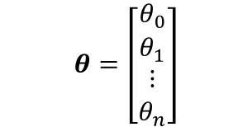
Linear Regression using the Normal Equation with numpy, scikit-learn and TensorFlow
For n dimensions with 1 instance:
Linear Regression with Numpy
$y=θ_{0}+θ_{1}x_{1}+θ_{2}x_{2}$+…+$θ_{n}x_{n}$
For n dimensions with m instances:
Hints:
Inverse of matrix:
np.linalg.inv()
Dot product of two array:
a.dot(b)
Transpose of matrix:
a.T
$$y=Xθ$$
$$X=\left[\begin{matrix}\begin{matrix}1 & x_{1}^{1} \\ 1 & x_{1}^{2}\end{matrix} & ⋯ & \begin{matrix}x_{n}^{1} \\ x_{n}^{2}\end{matrix} \\ ⋮ & ⋯ & ⋮ \\ \begin{matrix}1 & x_{1}^{m}\end{matrix} & ⋯ & x_{n}^{m}\end{matrix}\right]$$
$$y=\left[\begin{matrix}\begin{matrix}y^{1} \\ y^{2}\end{matrix} \\ \begin{matrix}⋮ \\ y^{m}\end{matrix}\end{matrix}\right]$$
$$θ=\left[\begin{matrix}\begin{matrix}θ_{0} \\ θ_{1}\end{matrix} \\ \begin{matrix}⋮ \\ θ_{n}\end{matrix}\end{matrix}\right]$$
The Normal Equation – a closed-form solution
$$\hat{θ}={\left(X^{T}X\right)}^{−1}X^{T}y$$

Slide 21
Linear Regression using the Normal Equation with numpy, scikit-learn and TensorFlow
For n dimensions with 1 instance:
Linear Regression with Scikit-learn
$y=θ_{0}+θ_{1}x_{1}+θ_{2}x_{2}$+…+$θ_{n}x_{n}$
For n dimensions with m instances:
Hints:
Use LinearRegression from sklearn.linear_model
$$y=Xθ$$
$$X=\left[\begin{matrix}\begin{matrix}1 & x_{1}^{1} \\ 1 & x_{1}^{2}\end{matrix} & ⋯ & \begin{matrix}x_{n}^{1} \\ x_{n}^{2}\end{matrix} \\ ⋮ & ⋯ & ⋮ \\ \begin{matrix}1 & x_{1}^{m}\end{matrix} & ⋯ & x_{n}^{m}\end{matrix}\right]$$
$$y=\left[\begin{matrix}\begin{matrix}y^{1} \\ y^{2}\end{matrix} \\ \begin{matrix}⋮ \\ y^{m}\end{matrix}\end{matrix}\right]$$
$$θ=\left[\begin{matrix}\begin{matrix}θ_{0} \\ θ_{1}\end{matrix} \\ \begin{matrix}⋮ \\ θ_{n}\end{matrix}\end{matrix}\right]$$
The Normal Equation – a closed-form solution
$$\hat{θ}={\left(X^{T}X\right)}^{−1}X^{T}y$$

Slide 22
Linear Regression using the Normal Equation with numpy, scikit-learn and TensorFlow
For n dimensions with 1 instance:
Linear Regression with TensorFlow
$y=θ_{0}+θ_{1}x_{1}+θ_{2}x_{2}$+…+$θ_{n}x_{n}$
For n dimensions with m instances:
Hints:
Inverse of matrix:
tf.matrix_inverse()
Dot product of two array:
tf.matmul(a, b)
Transpose of matrix:
tf.transpose(a)
$$y=Xθ$$
$$X=\left[\begin{matrix}\begin{matrix}1 & x_{1}^{1} \\ 1 & x_{1}^{2}\end{matrix} & ⋯ & \begin{matrix}x_{n}^{1} \\ x_{n}^{2}\end{matrix} \\ ⋮ & ⋯ & ⋮ \\ \begin{matrix}1 & x_{1}^{m}\end{matrix} & ⋯ & x_{n}^{m}\end{matrix}\right]$$
$$y=\left[\begin{matrix}\begin{matrix}y^{1} \\ y^{2}\end{matrix} \\ \begin{matrix}⋮ \\ y^{m}\end{matrix}\end{matrix}\right]$$
$$θ=\left[\begin{matrix}\begin{matrix}θ_{0} \\ θ_{1}\end{matrix} \\ \begin{matrix}⋮ \\ θ_{n}\end{matrix}\end{matrix}\right]$$
The Normal Equation – a closed-form solution
$$\hat{θ}={\left(X^{T}X\right)}^{−1}X^{T}y$$

Slide 23
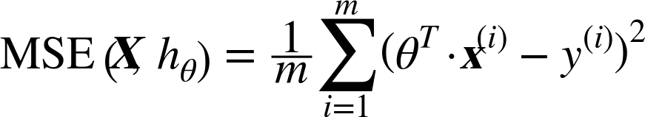
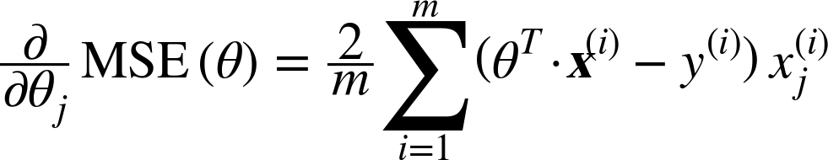
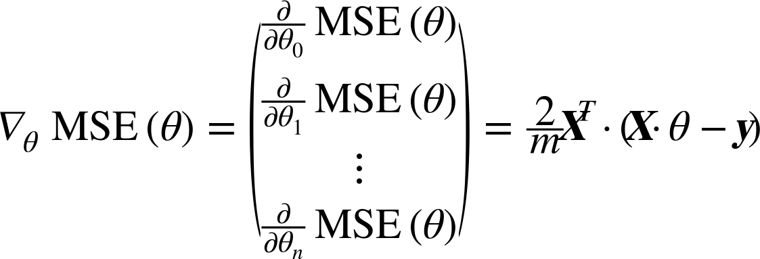
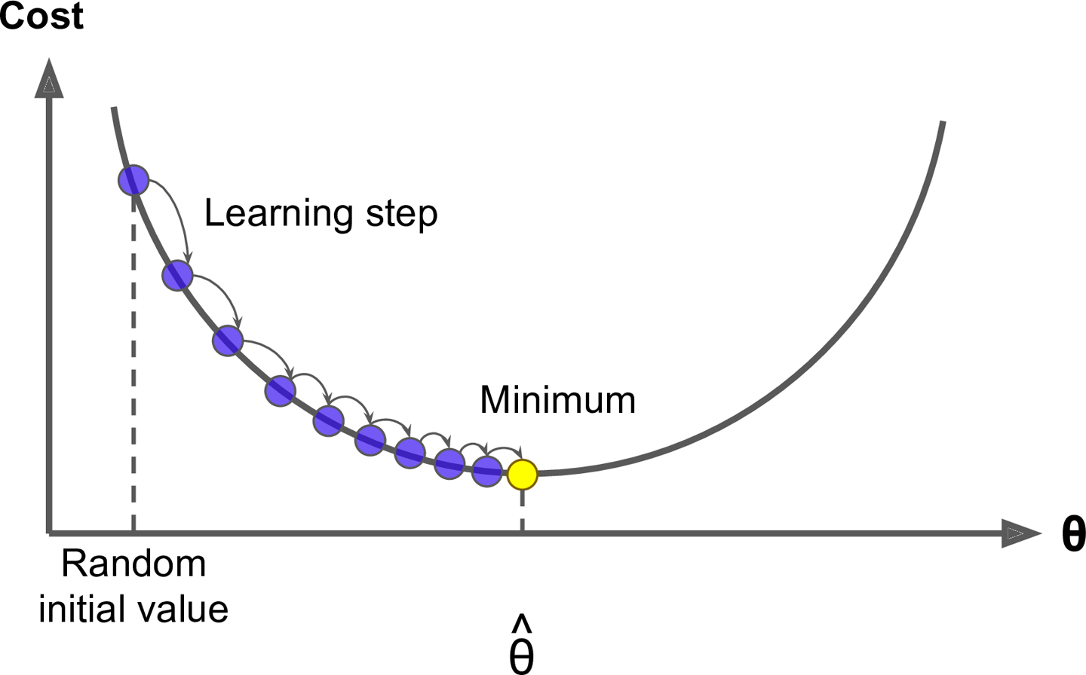
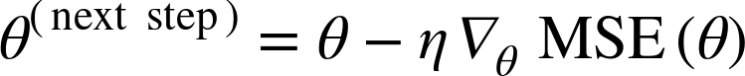
Implementing Batch Gradient Descent
TODO:
Do batch gradient descent by manually computing the gradients
Use TesorFlow’s autodiff feature to let TensorFlow compute the gradients automatically
Use TensorFlow’s out-of-the-box optimizers
Cost:

Slide 24
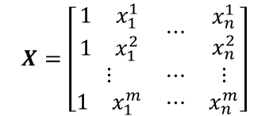
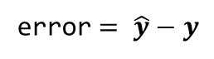
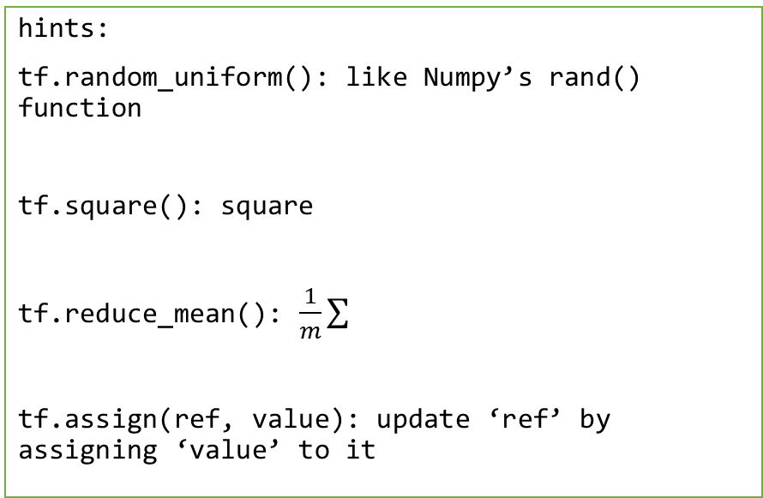
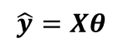
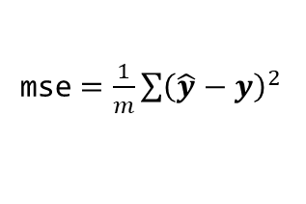
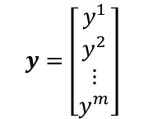

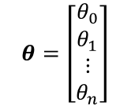
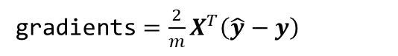
Implementing Batch Gradient Descent
Do batch gradient descent by manually computing the gradients
$$X=\left[\begin{matrix}\begin{matrix}1 & x_{1}^{1} \\ 1 & x_{1}^{2}\end{matrix} & ⋯ & \begin{matrix}x_{n}^{1} \\ x_{n}^{2}\end{matrix} \\ ⋮ & ⋯ & ⋮ \\ \begin{matrix}1 & x_{1}^{m}\end{matrix} & ⋯ & x_{n}^{m}\end{matrix}\right]$$
$$y=\left[\begin{matrix}\begin{matrix}y^{1} \\ y^{2}\end{matrix} \\ \begin{matrix}⋮ \\ y^{m}\end{matrix}\end{matrix}\right]$$
Constant:
hints:
tf.random_uniform(): like Numpy’s rand() function
tf.square(): square
tf.reduce_mean(): $\frac{1}{m}\sum{}$
tf.assign(ref, value): update ‘ref’ by assigning ‘value’ to it
Variable with random uniform distribution from -1 to 1 :
$$θ=\left[\begin{matrix}\begin{matrix}θ_{0} \\ θ_{1}\end{matrix} \\ \begin{matrix}⋮ \\ θ_{n}\end{matrix}\end{matrix}\right]$$
$$\hat{y}=Xθ$$
error$= \hat{y}−y$
mse$=\frac{1}{m}\sum{{\left(\hat{y}−y\right)}^{2} }$
gradients$=\frac{2}{m}X^{T}\left(\hat{y}−y\right)$
training_op$=θ≔θ−η$gradients
Run the graph on the session

Slide 25
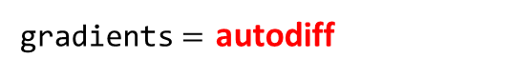
Implementing Batch Gradient Descent
Use TesorFlow’s autodiff feature to let TensorFlow compute the gradients automatically
$$X=\left[\begin{matrix}\begin{matrix}1 & x_{1}^{1} \\ 1 & x_{1}^{2}\end{matrix} & ⋯ & \begin{matrix}x_{n}^{1} \\ x_{n}^{2}\end{matrix} \\ ⋮ & ⋯ & ⋮ \\ \begin{matrix}1 & x_{1}^{m}\end{matrix} & ⋯ & x_{n}^{m}\end{matrix}\right]$$
$$y=\left[\begin{matrix}\begin{matrix}y^{1} \\ y^{2}\end{matrix} \\ \begin{matrix}⋮ \\ y^{m}\end{matrix}\end{matrix}\right]$$
Constant:
Variable with random uniform distribution from -1 to 1 :
$$θ=\left[\begin{matrix}\begin{matrix}θ_{0} \\ θ_{1}\end{matrix} \\ \begin{matrix}⋮ \\ θ_{n}\end{matrix}\end{matrix}\right]$$
$$\hat{y}=Xθ$$
error$= \hat{y}−y$
mse$=\frac{1}{m}\sum{{\left(\hat{y}−y\right)}^{2} }$
hints:
tf.gradients(op, x_list): creates a list of gradients of ops w.r.t. x in x_list
gradients$=$ autodiff
training_op$=θ≔θ−η$gradients
Run the graph on the session

Slide 26

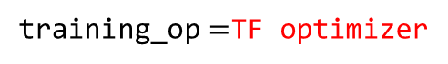
Implementing Batch Gradient Descent
Use TensorFlow’s out-of-the-box optimizers
$$X=\left[\begin{matrix}\begin{matrix}1 & x_{1}^{1} \\ 1 & x_{1}^{2}\end{matrix} & ⋯ & \begin{matrix}x_{n}^{1} \\ x_{n}^{2}\end{matrix} \\ ⋮ & ⋯ & ⋮ \\ \begin{matrix}1 & x_{1}^{m}\end{matrix} & ⋯ & x_{n}^{m}\end{matrix}\right]$$
$$y=\left[\begin{matrix}\begin{matrix}y^{1} \\ y^{2}\end{matrix} \\ \begin{matrix}⋮ \\ y^{m}\end{matrix}\end{matrix}\right]$$
Constant:
Variable with random uniform distribution from -1 to 1 :
$$θ=\left[\begin{matrix}\begin{matrix}θ_{0} \\ θ_{1}\end{matrix} \\ \begin{matrix}⋮ \\ θ_{n}\end{matrix}\end{matrix}\right]$$
$$\hat{y}=Xθ$$
error$= \hat{y}−y$
mse$=\frac{1}{m}\sum{{\left(\hat{y}−y\right)}^{2} }$
hints:
optimizer = tf.train.GradientDescentOptimizer(…)
training_op = optimizer.minimize(mse)
gradients$=$ autodiff
training_op$=$TF optimizer
Run the graph on the session

Slide 27
Mini-batch Gradient Descent
Batch Gradient Descent
Stochastic Gradient Descent
Mini-batch Gradient Descent
A | B
A | B
A | B

Slide 28
Placeholder
B
A = tf.constant([1, 2, 3], dtype=tf.float32)
B = A + 5
with tf.Session() as sess:
B_val = sess.run(B)
+
A = [1,2,3]
5
B
A = tf.placeholder(tf.float32, shape=(None, 3))
B = A + 5
with tf.Session() as sess:
B_val1 = sess.run(B, feed_dict={A: [[1, 2, 3]]})
B_val2 = sess.run(B, feed_dict={A: [[1, 2, 3], [4, 5, 6]]})
+
A
5
feed array from session

Slide 29
Implementing mini-batch gradient descent
X = tf.constant(data)
y = tf.constant(label)
.
.
.
with tf.Session() as sess:
…
sess.run(training_op)
X = tf.placeholder(tf.float32, shape=(None, n + 1))
y = tf.placeholder(tf.float32, shape=(None, 1))
.
.
.
def fetch_batch(…):
…
return X_batch, y_batch
with tf.Session() as sess:
…
X_batch, y_batch = fetch_batch(…)
sess.run(training_op, feed_dict={X: X_batch, y: y_batch})

Slide 30
Saving and Restoring Models
<Saving Models>
<Restoring Models>
import tensorflow as tf
…
…
saver = tf.train.Saver()
import tensorflow as tf
…
…
saver = tf.train.Saver()
Construction phase
Construction phase
Execution phase
Execution phase
with tf.Session() as sess:
…
save_path = saver.save(sess, “./model.ckpt”)
with tf.Session() as sess:
saver.restore(sess, “./model.ckpt”)
…

Slide 31
Restoring Models without Graphs
<Restoring Models with Graph>
<Restoring Models without Graphs>
import tensorflow as tf
…
…
saver = tf.train.Saver()
import tensorflow as tf
Construction phase
Construction phase
saver = tf.train.import_meta_graph(“./model.ckpt.meta")
theta =
tf.get_default_graph().get_tensor_by_name(..)
Execution phase
Execution phase
with tf.Session() as sess:
saver.restore(sess, “./model.ckpt")
with tf.Session() as sess:
saver.restore(sess, “./model.ckpt”)
…

Slide 32
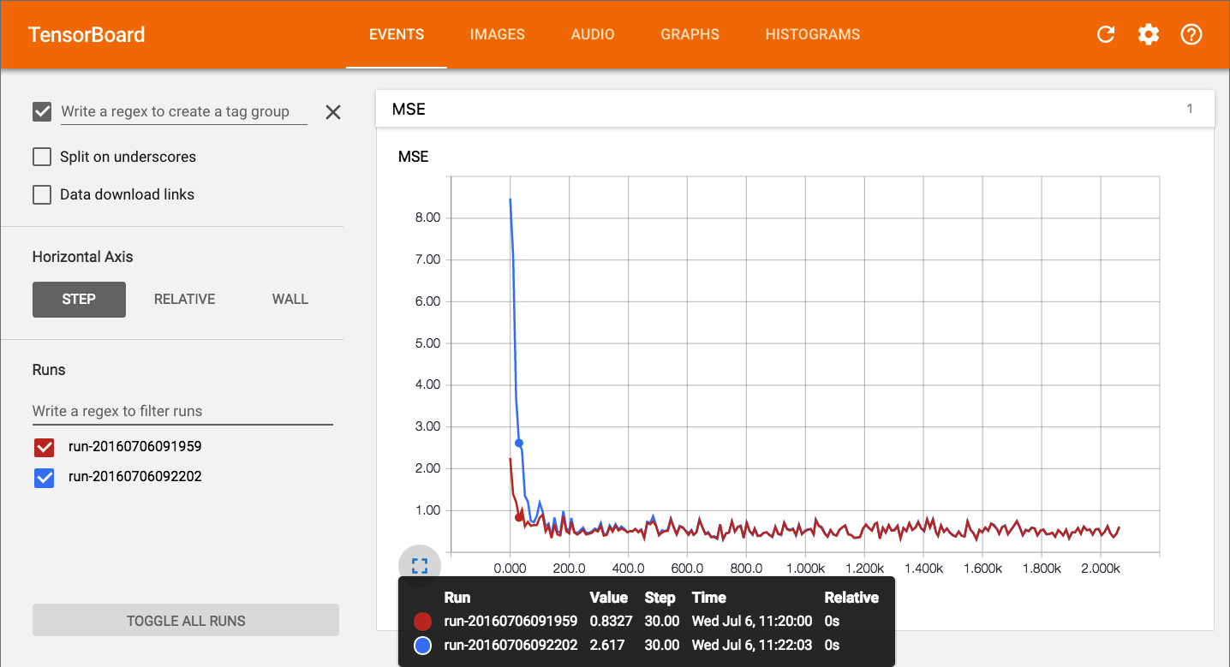
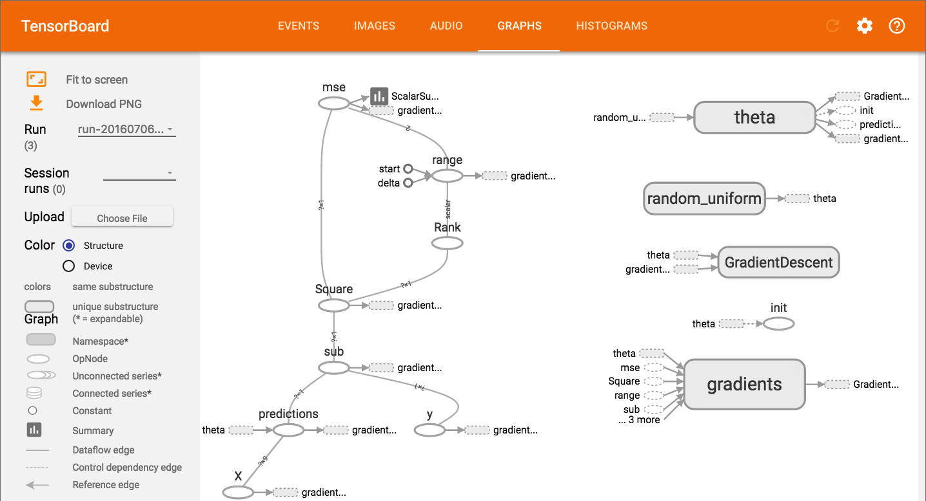
TensorBoard
TF logging/debugging tool
Visualize the TF graph
Plot quantitative metrics
Show additional data

Slide 33
TensorBoard
…
…
mse_summary = tf.summary.scalar(‘MSE’, mse)
file_writer = tf.summary.FileWriter(“./tf_logs/run1”, tf.get_default_graph())
Construction phase
Execution phase
with tf.Session() as sess:
…
summary_str = sess.run(mse_summary, feed_dict={X: X_batch, y: y_batch})
file_writer.add_summary(summary_str, step)
…
file_writer.close()

Slide 34
TensorBoard
from datetime import datetime
now = datetime.utcnow().strftime(“%Y%m%d%H%M%S”)
root_logdir = "./tf_logs"
logdir = "{}/run-{}/".format(root_logdir, now)
…
…
mse_summary = tf.summary.scalar(‘MSE’, mse)
file_writer = tf.summary.FileWriter(logdir, tf.get_default_graph())
Construction phase
Execution phase
with tf.Session() as sess:
…
summary_str = sess.run(mse_summary, feed_dict={X: X_batch, y: y_batch})
file_writer.add_summary(summary_str, step)
…
file_writer.close()

Slide 35
To launch TensorBoard
open terminal and type:
$ tensorboard --logdir=your root log directory such as ./tf_logs/
then open a browser and go to http://localhost:6006/

Slide 36
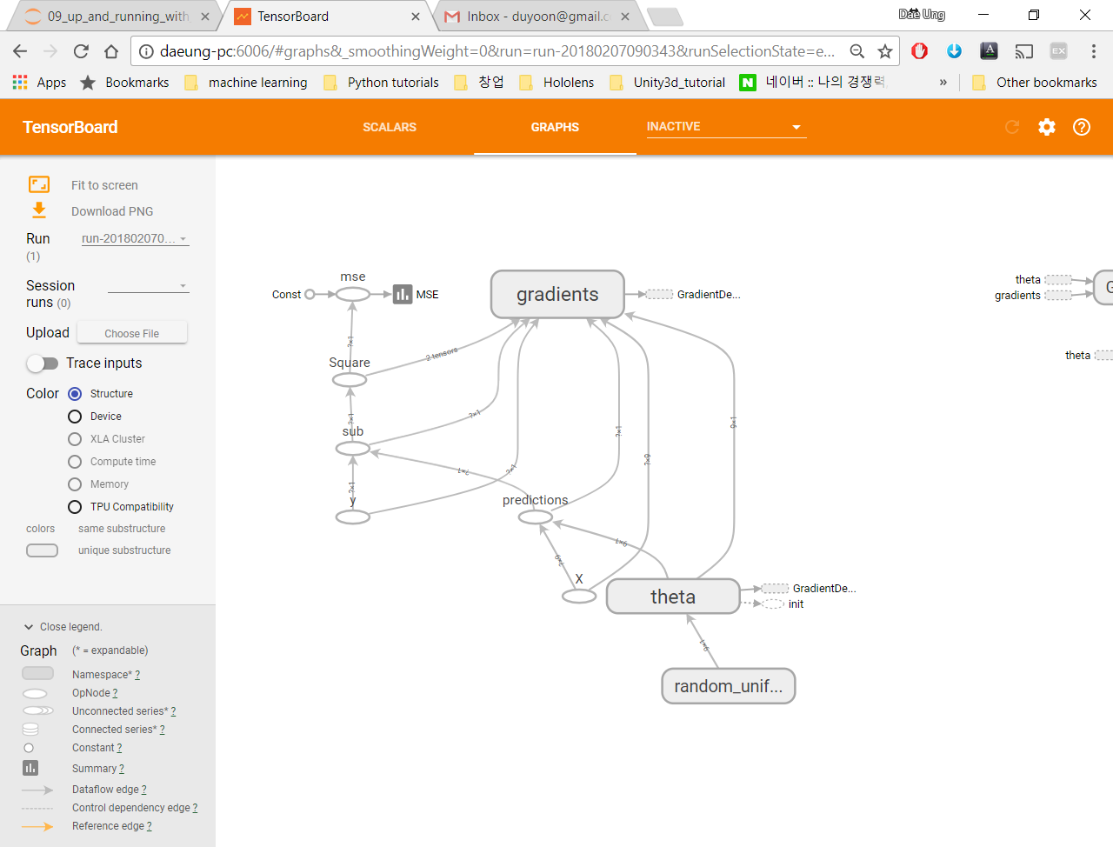
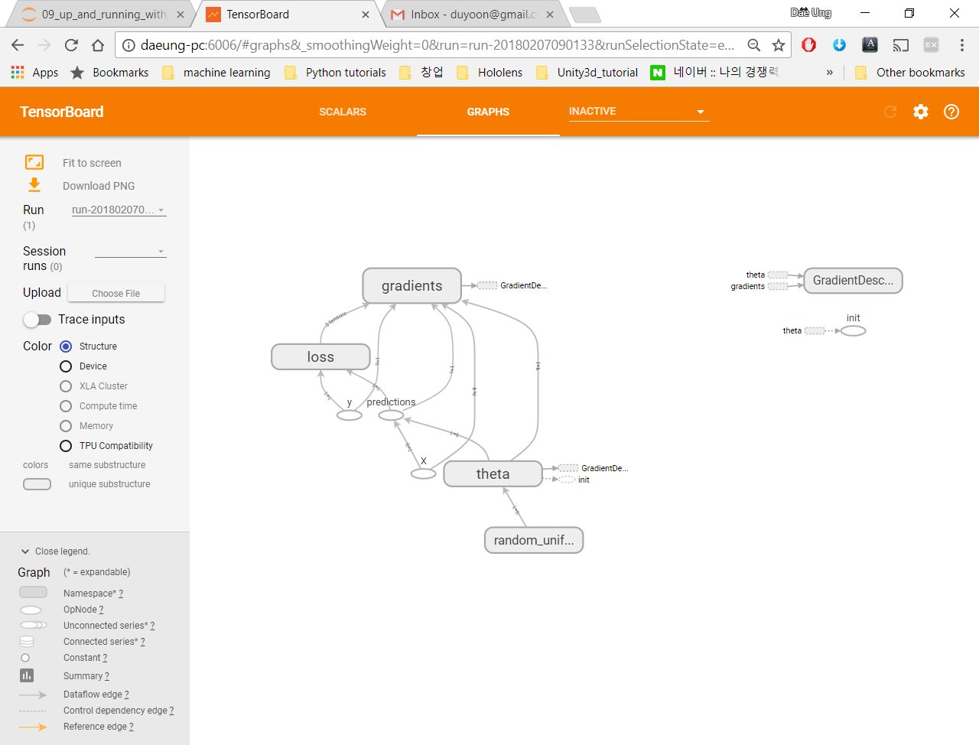
Name Scopes
error = y_pred - y
mse = tf.reduce_mean(tf.square(error), name="mse")
with tf.name_scope(“loss”) as scope:
error = y_pred – y
mse = tf.reduce_mean(tf.square(error), name=“mse”)

Slide 37
9. Introduction to Artificial Neural Networks

Slide 38
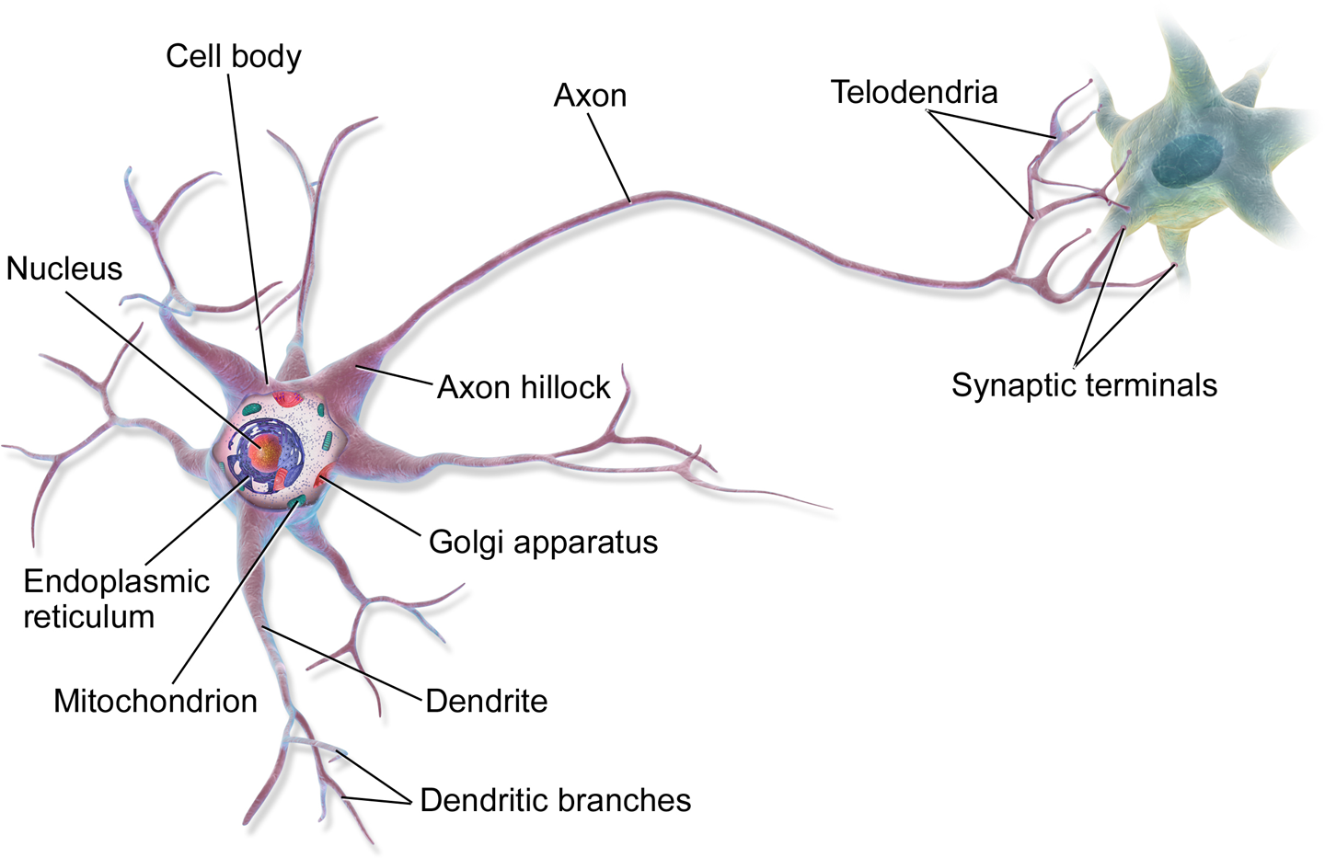
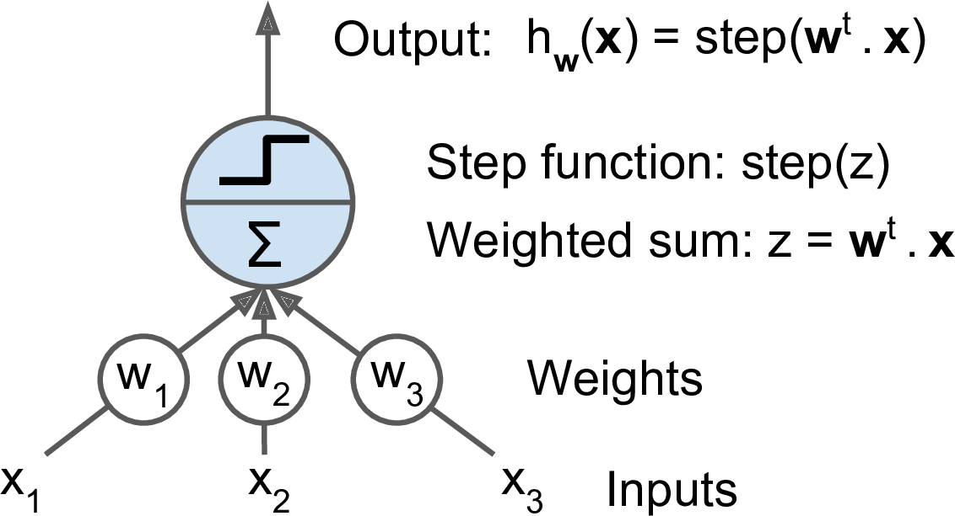
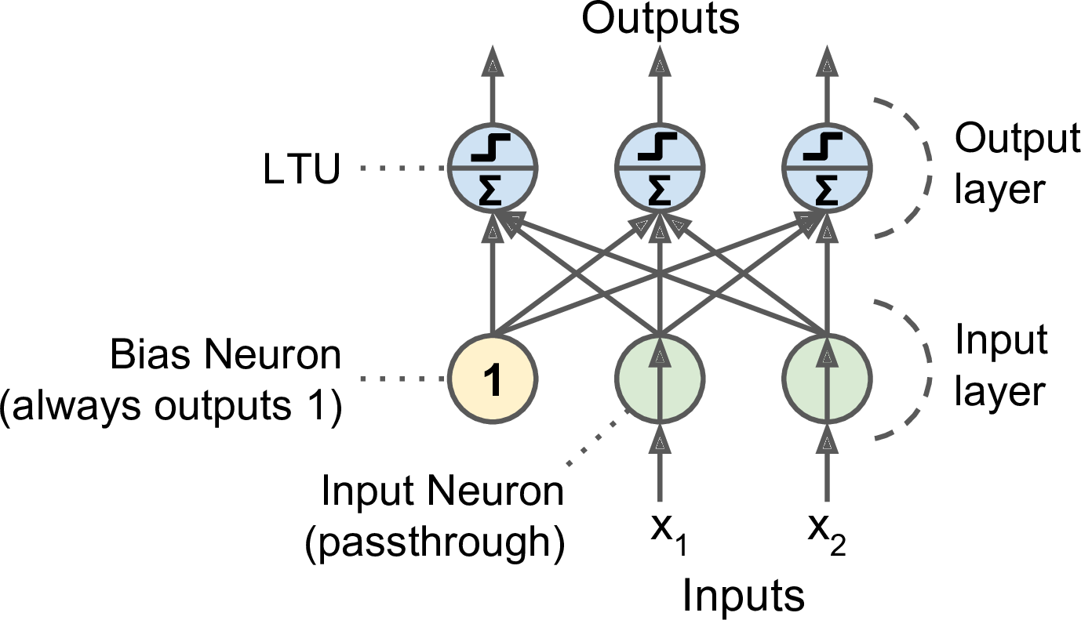
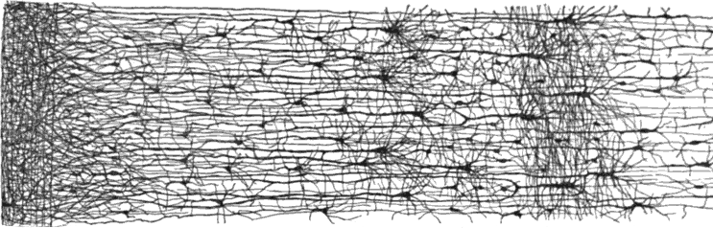
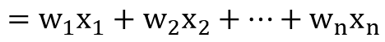
Biological Neuron vs. Artificial Neuron
$$=w_{1}x_{1}+w_{2}x_{2}+…+w_{n}x_{n}$$
Linear threshold unit (LTU)
Biological neuron
Multiple layers in a biological neural network (human cortex)
Perceptron

Slide 39
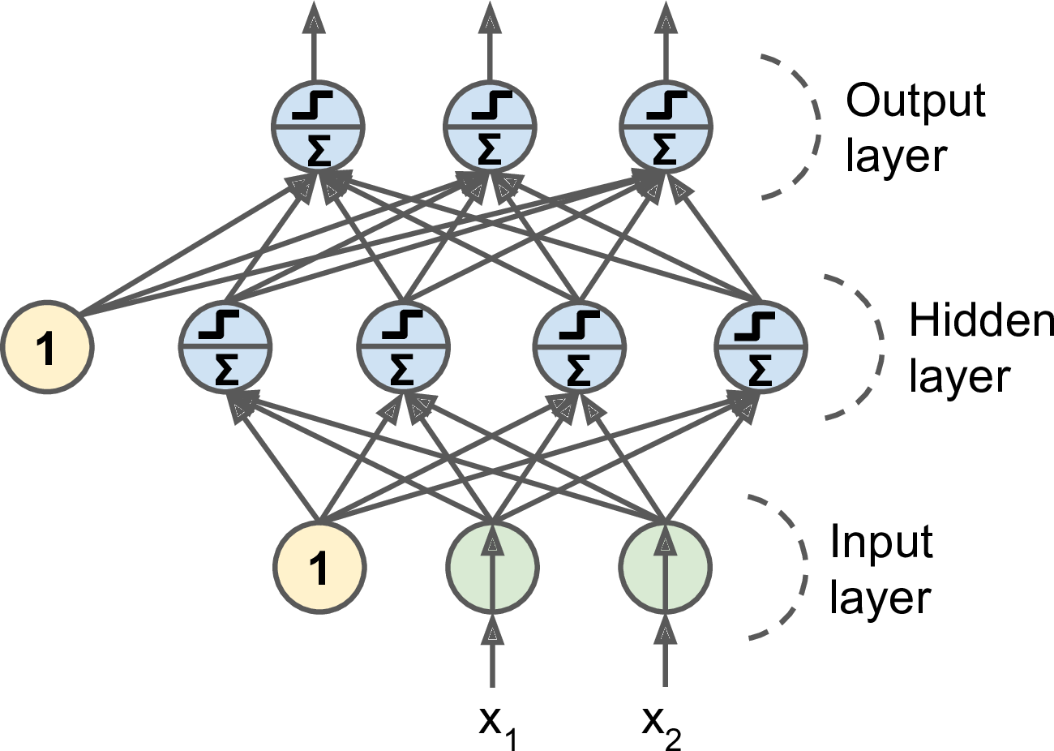
Artificial Neural Networks
Linear threshold unit (LTU)
Multi-Layer Perceptron
Perceptron

Slide 40
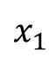
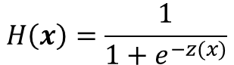
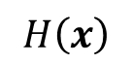
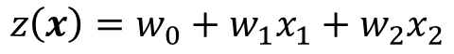
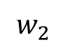
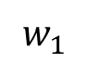
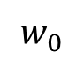
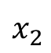
Logistic Regression
Statistical classification model
Predicts binary response from a binary predictor for predicting the outcome of a categorical dependent variable
Training Data:
Label : 1 0
Logit:
$$z\left(x\right)=w_{0}+w_{1}x_{1}+w_{2}x_{2}$$
$$H\left(x\right)=\frac{1}{1+e^{−z(x)}}$$
Hypothesis:
1
$$w_{0}$$
x₂
$$x_{1}$$
$$w_{1}$$
$$H\left(x\right)$$
$$w_{2}$$
$$x_{2}$$
x₁

Slide 41
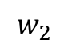
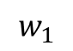
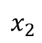
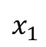
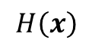
Logistic Regression vs. MLP
Logistic Regression
x₂
$$x_{1}$$
$$w_{1}$$
$$w_{2}$$
$$H\left(x\right)$$
$$x_{2}$$
x₁

Slide 42
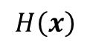
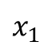
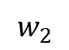








Logistic Regression vs. MLP
$$x_{1}$$
$$w_{1}$$
$$w_{2}$$
$$x_{2}$$
x₂
$$x_{1}$$
$$w_{3}$$
$$w_{4}$$
$$H\left(x\right)$$
$$x_{2}$$
x₁
$$x_{1}$$
$$w_{5}$$
$$w_{6}$$
$$x_{2}$$

Slide 43

Logistic Regression vs. MLP
x₂
$$x_{1}$$
$$H\left(x\right)$$
$$x_{2}$$
x₁
hidden layers

Slide 44

Activation Functions

Slide 45

Modern Multi-Layer Perceptron (MLP)
Multi-Layer Perceptron
A modern MLP (including ReLU and softmax) for classification

Slide 46



Deep Neural Networks (DNN)
output layer
input layer
hidden layers

Slide 47


Deep Neural Networks (DNN)
output layer
input layer
hidden layers

Slide 48


Deep Neural Networks (DNN)
Softmax Classifier
ex)
2.0
0.7
1.0
0.2
softmax
0.1
0.1
softmax
output layer
input layer
hidden layers

Slide 49

Simple DNN for MNIST with TensorFlow
Input layer
28x28 = 784
hidden layer 1
300
hidden layer 2
100
output layer
10
W1
(784x300)
W2
(300x100)
W3
(100x10)

Slide 50
10. Training Deep Neural Nets

Slide 51
Deeper Neural Networks: Problems & Solutions
Vanishing/Exploding Gradients Problems
Xavier and He Initialization
Nonsaturating Activation Functions
Batch Normalization
Gradient Clipping
Overfitting
Batch Normalization
Early Stopping
L1 and L2 Regularization
Dropout
Max-Norm Regularization
Data Augmentation
Slow Training
Faster Optimizers

Slide 52


Vanishing/Exploding Gradient Problems

Slide 53












Backward Propagation
$$w_{1}$$
$$w_{2}$$
$$x$$
$$g\left(w_{1}x\right)=h_{1}$$
$g\left(w_{2}h_{1}\right)=h_{2}$
$$h_{2}$$
➔$Cost=C\left(y, h_{2}\right)$
To calculate partial derivative of the cost function w.r.t. $w_{1}$,
First, find partial derivative at each node:
$$\frac{∂h_{1}}{∂w_{1}}=g^{′}\left(w_{1}x\right)x$$
$$\frac{∂h_{2}}{∂h_{1}}=g^{′}\left(w_{2}h_{1}\right)w_{2}$$
$$\frac{∂C}{∂h_{2}}=C′$$
Then, using the chain rule:
$$\frac{∂C}{∂w_{1}}=\frac{∂C}{∂h_{2}}×\frac{∂h_{2}}{∂h_{1}}×\frac{∂h_{1}}{∂w_{1}}=C′×g^{′}\left(w_{2}h_{1}\right)w_{2}×g^{′}\left(w_{1}x\right)x$$

Slide 54



Vanishing/Exploding Gradient Problems
…
$$x$$
$h_{n}$
$$\frac{∂C}{∂w_{1}}=\frac{∂C}{∂h_{n}}×\frac{∂h_{n}}{∂h_{n−1}}×\frac{∂h_{n−1}}{∂h_{n−2}}×…×\frac{∂h_{1}}{∂w_{1}}=C^{′}×g^{′}\left(z_{n}\right)w_{n−1}×g^{′}\left(z_{n−1}\right)w_{n−2}×…×g^{′}\left(z_{1}\right)x$$
Small derivative of activation function, $g^{′}\left(z\right)$ or weights, $w$ ➔ Vanishing gradient
Large derivative of activation function, $g^{′}\left(z\right)$ or weights, $w$ ➔ Exploding gradient
Note: input $x$needs the scale transform (e.g., standard normalization)

Slide 55




Activation Functions
…
$$x$$
$h_{n}$
$$\frac{∂C}{∂w_{1}}=\frac{∂C}{∂h_{n}}×\frac{∂h_{n}}{∂h_{n−1}}×\frac{∂h_{n−1}}{∂h_{n−2}}×…×\frac{∂h_{1}}{∂w_{1}}=C^{′}×g^{′}\left(z_{n}\right)w_{n−1}×g^{′}\left(z_{n−1}\right)w_{n−2}×…×g^{′}\left(z_{1}\right)x$$
Small derivative of activation function, $g^{′}\left(z\right)$ ➔ Vanishing gradient
Saturating
Saturating
Sigmoid and Tanh Activation Functions

Slide 56
Nonsaturating Activation Functions

Slide 57


Xavier/He initialization
Makes sure the weights are ‘just right’, not too small, not too big
The ‘just right’ weights cause:
the variance of the output of each layer to be equal to the variance of its inputs
the gradients to have equal variance before and after flowing through a layer
$$Var\left(in\right)=Var(out)$$
$$Var\left(grad_out\right)=Var(grad_in)$$
Forward propagation
Backward propagation

Slide 58
Xavier/He initialization
Makes sure the weights are ‘just right’, not too small, not too big
Using number of input (fan-in) and output (fan-out)
fan-out
fan-in
w
# Xavier initialization (Glorot et al. 2010)
W = np.random.randn(fan_in, fan_out)/np.sqrt(fan_in)
# He initialization (He et al. 2015)
W = np.random.randn(fan_in, fan_out)/np.sqrt(fan_in/2)

Slide 59
Xavier/He initialization
Makes sure the weights are ‘just right’, not too small, not too big
Using number of input (fan-in) and output (fan-out)
Xavier/He initialization reduce the vanishing/exploding gradients problems at the beginning of training.
However, it doesn’t guarantee that they won’t come back during training!

Slide 60
Batch Normalization
Xavier/He Initialization
During training w/o BN
During training w/ BN
Internal Covariate Shift Problem

Slide 61


Advantages of Batch Normalization
Reduces the vanishing gradients problem
Speed up the learning process
Improves accuracy
Regularization
Without BN
Classifier says: Not Cat!
Classifier says: Cat!
Internal Covariate Shift Problem

Slide 62
Advantages of Batch Normalization
Reduces the vanishing gradients problem
Speed up the learning process
Improves accuracy
Regularization
With BN
Classifier says: Cat!
Classifier says: Cat!

Slide 63
Overfitting Problem
Batch Normalization
Early Stopping
L1 and L2 Regularization
Dropout
Max-Norm Regularization
Data Augmentation

Slide 64

Dropout
At every training step, every neuron(including the input neurons but excluding the output neurons) is dropped out with a dropout rate.
Dropout is a kind of ensemble.

Slide 65







Faster Optimizers
Gradient Descent
AdaGrad
$$s←s+∇_{θ}J\left(θ\right)⊗∇_{θ}J\left(θ\right)$$
$$θ←θ−η∇_{θ}J\left(θ\right)⊘\sqrt{s+ε}$$
$$θ←θ−η∇_{θ}J(θ)$$
Momentum
RMSProp
$$m←βm+η∇_{θ}J\left(θ\right)$$
$$θ←θ−m$$
$$s←βs+(1−β)∇_{θ}J\left(θ\right)⊗∇_{θ}J\left(θ\right)$$
$$θ←θ−η∇_{θ}J\left(θ\right)⊘\sqrt{s+ε}$$
Nesterov Accelerated Gradient
Adam
$$m←β_{1}m+(1−β_{1})∇_{θ}J\left(θ\right)$$
$$s←β_{2}s+(1−β_{2})∇_{θ}J\left(θ\right)⊗∇_{θ}J\left(θ\right)$$
$$m←\frac{m}{1−β_{1}^{iter}}$$
$$s←\frac{s}{1−β_{2}^{iter}}$$
$$θ←θ−ηm⊘\sqrt{s+ε}$$
$$m←βm+η∇_{θ}J\left(θ+βm\right)$$
$$θ←θ−m$$
$⊗⊘:$ elementwise

Slide 66
Faster Optimizers in TensorFlow
Gradient Descent
tf.train.GradientDescentOptimizer(learning_rate=learning_rate)
Momentum
tf.train.MomentumOptimizer(learning_rate=learning_rate,momentum=0.9)
Nesterov
tf.train.MomentumOptimizer(learning_rate=learning_rate,momentum=0.9, use_nesterov=True)
AdaGrad
tf.train.AdagradOptimizer(learning_rate=learning_rate)
RMSProp
tf.train.RMSPropOptimizer(learning_rate=learning_rate,
decay=0.9, epsilon=1e-10)
Adam
tf.train.AdamOptimizer(learning_rate=learning_rate)

Slide 67


Learning Rate Scheduling
Predetermined piecewise constant learning rate
For example, $η=0.1$ at 1~50 epoch, $η=0.01$ at 51~100 epoch, etc.
Performance scheduling
Reduce learning rate if the validation error stops dropping
Exponential scheduling
$η(t)=η_{0}{10}^{−t/r}$
Reduce the learning rate by a facor of 10 every $r$ steps
Power scheduling
$η\left(t\right)=η_{0}{\left(1+\frac{t}{r}\right)}^{−c}$
Slower dropping than exponential scheduling

Slide 68
Default DNN configuration
Initialization | He initialization
Activation function | ELU
Normalization | Batch Normalization
Regularization | Dropout
Optimizer | Adam
Learning rate schedule | None

